Slide 1

Paycheck and Billing System: FarmaFACT
Select Topics on Computing Engineering II

Slide 2
Preface
To have all-in-one solutions to generate & store information related to purchasing & payroll documents on the market they exist different tolos that can achieve separately these actions
Not all software can be aligned and get approved by the government institution for tax recovery & administration

Slide 3
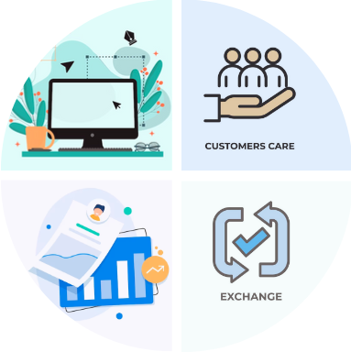
MVP
Easy-to-use design |  | Versatile & Dynamic System
For us, it’s crucial to have an intuitive & easy interface, so that implies to have a clean design and a clear browsing for your usage |  | We adapt our system to the on-demand premises, so we design the best platform and give you the best options according to your current business needs
Consolidated Data |  | Tx Monitoring
We use all the high-level security tools (data encryption & user multi-layer authentication methods) to secure the integrity and confidentiality of your information |  | We setlle real-time analytic tools to inspect & monitor all your currency transactions (Tx) and relevant events, so you can get all updated reports & security alerts

Slide 4
MVP
FarmaFACT brings an easier way to create, process & monitor all your company’s money transactions within your company employees and exchange transactions (Sales)
Lets you store your processes, transactions and file media on the Cloud, saving you costs on storage and file usage. (SaaS)
Aligns with your Tax implementations and local government’s mandatory regulations (CFDI 3.0)

Slide 5
Technical Design: Front End

Slide 6
Technical Design: Back End

Slide 7
Project Charter
Project ID |  | 01-A |  |  | Expected Start Date
Project Name |  | FarmaFACT |  |  | Expected Completion
Project Manager |  | Victor Hugo Barrera |  |  | Estimated Cost
Project Sponsor |  | STC |  |  | Estimated Savings
Purpose
Develop and build a tool that can create and process within the same platform database & structure for capturing the product purchasing and digital billing to clients that could generate invoices based on CFDI 3.3 regulations and issuing payment receipts to employees.
Objective |  |  |  |  | Scope
Specific goals the project aims to achieve |  |  |  |  | Boundaries of the project, including what is in and out
Must have an intuitive & easy interface, so that implies to have a clean design and a clear browsing for end-user. |  |  |  |  | This program is not yet aligned with the 4.0 version of the CFDI tax setup, will require further development
Have multi-layer authentication methods and data encyption to secure the integrity and confidentiality of all the information |  |  |  |  | As a test program, it only includes limited values for products and end-user accounts
Implement real-time analytic tools to inspect & monitor all currency transactions (Tx) and relevant events, so all reports can trigger & show all relevant actions.
Deliverables |  |  |  |  | Stakeholders
Tangible or intangible products to be delivered |  |  |  |  | Key people with an interest in the project
A web-based application that lets the end-user log in as a different type (administrator/payroll employee/client/auditor) |  |  |  |  | External clients
Depending the user type the access setup differs and lets the user control the application depending the need. |  |  |  |  | Internal employees
 |  |  |  |  | Internal & external auditors
Roles & Responsibilities
 | Name | Role | Role |  | Responsibilities
1 | Aranza Abril Núñez Luna | Business Analyst (BA) | Business Analyst (BA) |  | Responsible for making a quick analysis of the business needs and its solutions
2 | Diego Jair Crisantos Martinez | Testing Engineer (QA) | Testing Engineer (QA) |  | Responsible for making all testing cases once the application is created
3 | Issac Alexander Guerrero Prado | Developer (Dev) | Developer (Dev) |  | Responsible for creating a solid and strong coding for all the process
4 | María Guadalupe Martínez Pavón | Database Analyst (DBA) | Database Analyst (DBA) |  | Responsible for building a solid and consistent database for the application purposes
5 | Víctor Hugo Barrera Arenas | Project Leader (PM) | Project Leader (PM) |  | Responsible to align the members of the team to deliver the product as per compliance and product requirements and be the head of the team for the STC
Tentative Schedule
 | Milestone | Description |  |  | Start | Finish
1 | DB Testing | Have a functional database testing version of the platform |  |  | 30-Mar-2024 | 13-Apr-2024
2 | General Testing | Make minimal fixes & debug for general testing |  |  | 13-Apr-2024 | 27-Apr-2024
3 | Proving Evidences | Gather all testing evidences to fix & push deploy on production |  |  | 27-Apr-2024 | 11-May-2024
4 | App Deployment | Release the application on Production |  |  | 11-May-2024 | 25-May-2024
5 | Delivery & Project Closure | Changing controls & Project closure |  |  | 25-May-2024 | 1-Jun-2024
Risks & Mitigation
 | Risk | Mitigation |  | Remarks
1 | Other competitors may offer a lower-cost solution | Negotiate with High Management and show benefits or the product on a long-term period against a license acquisition of an external software. |  | Will negotiate if needed the possibility to extend the delivery due date for the product releasing
2 | Team member suffers equipment loss due to theft or remote lockout | Verify backups and/or drafts of the database among team members. Back up information both in physical format and in corporate cloud or cloud accounts to avoid data loss and rework. |  | Project review and bugs fixed, the database version was restored and project development could be resumed. 18-Apr-2024
3 | Common sick illness | If a member is sick, return them home and, if possible, work remotely and connect virtually for important meetings if required so the member can recover properly. |  | Due to the global health situation, this case may be filed again, so it does not have a set validity or expiration date.
4 | Software execution error | Use simple programs to create tables and databases to connect them with software that is easy to manipulate and connect to avoid delays. |  | A database expert was contacted and managed to connect the database to the software code and managed to fulfill the task of connecting and generating the requested files.
Approvals
 | Name | Approval Date |  | Role
1 | Victor Hugo Barrera Arenas | 31-May-2024 |  | Project Manager
2
3
4
5

Slide 8
RACI Matrix
Stage | Process | BA | QA | Dev | DBA | Leader
Analysis | Requirement List | R | A | C | C | I
 | Database Analysis (DB) | I | A | C | C | I
 | Design Analysis | C | R | I | I | A
Design | Database Modeling | I | A | C | C | I
 | Graphic Interface Design | C | C | R | R | A
 | Architecture Design | I | C | R | R | A
Development | Catalog Implementation | C | I | I | I | A
 | Backend Development | I | A | R | R | I
 | Graphic Interface Development | C | A | R | R | I
 | Infrastructure Creation | C | A | R | R | I
 | Flux Deployment Creation | I | A | R | I | I
 | Containers Creation | I | R | A | I | I
Testing | DB Testing | R | A | C | I | I
 | General Testing | A | R | I | C | A
 | Proving Evidences | A | R | I | I | C
 | GUI Units Testing | R | A | I | I | C
Product Release | App Deployment | R | C | I | I | A
Project management | Business Planning | 1 | 1 | 1 | 1 | R
 | Risks Analysis | 1 | 1 | 1 | 1 | R
 | Change Controls | 1 | 1 | 1 | 1 | R
 | Delivery & Project Closure | C | R | I | C | A

Slide 9
Project Timing Costs
Stage | Process | BA | QA | Dev | DBA | Leader
Analysis | Requirement List |  | 2 | 6 |  | 1.5
 | Database Analysis (DB) | 3 |  | 1 |  | 0.5
 | Design Analysis | 2 |  | 2 |  | 0.5
Subtotal |  | 5 | 2 | 9 | 0 | 2.5
Design | Database Modeling |  | 6 | 8 |  | 0.5
 | Graphic Interface Design |  | 8 | 8 |  | 0.5
 | Architecture Design |  |  | 2
Subtotal |  | 0 | 14 | 18 | 0 | 1
Development | Catalog Implementation |  |  | 6 |  | 0.5
 | Backend Development |  | 60 | 60 |  | 0.5
 | Graphic Interface Development |  | 40 |  | 90 | 0.5
 | Infrastructure Creation |  | 12 | 6 | 15 | 0.5
 | Flux Deployment Creation | 0.5 | 0.5 | 4 | 10 | 0.5
 | Containers Creation |  |  | 8 |  | 0.5
Subtotal |  | 0.5 | 112.5 | 84 | 115 | 3
Testing | DB Testing |  |  |  |  | 0.5
 | General Testing | 60 |  |  |  | 0.5
 | Proving Evidences | 24 | 12 |  | 24 | 1
 | GUI Units Testing |  |  |  | 44 | 0.5
Subtotal |  | 84 | 12 | 0 | 68 | 2.5
Product Release | App Deployment |  |  |  | 1.5 | 0.5
Subtotal |  | 0 | 0 | 0 | 1.5 | 0.5
Project management | Business Planning | 1 | 1 | 1 | 1 | 16
 | Risks Analysis | 1 | 1 | 1 | 1 | 5
 | Change Controls | 1 | 1 | 1 | 1 | 8
 | Delivery & Project Closure |  |  |  | 0.5 | 1
Subtotal |  | 3 | 3 | 3 | 3.5 | 30
Total (h) |  | 92.5 | 143.5 | 114 | 186.5 | 39

Slide 10
Project Risks & Issues
Risk Assessment |  |  |  |  |  |  |  |  |  | 14 | Risk Management
Affected Team | ID | Root Cause | Description of the risk/issue + Impact | Effect |  |  |  | Total Effect | Probabilty | Severity (E*P) | Preventive Actions: Avoid or Reduce | Contingent Action (what to do in case of) | Due date | Responsible | Action Detonator | State (open/close) | Progress notes
 |  |  |  | Plan | Efforts | Cost | Quality
Purchasing | 1 | Long-term project and the use of software with fluctuating prices in the market | Risk: Other competitors may offer a lower-cost solution Impact: We will not have the project budget under control, and may lose the project release | 1 | 1 | 5 | 4 | 5 | 2 | 10 | Negotiate with High Management and show benefits or the product on a long-term period against a license acquisition of an external software. | Begin negotiation with High Management and end-users’ Directors to show the benefits of using internal software against a license purchasing on a long-term basis. | 31/05/24 | Team Leader | Product usage escalations & product complaints. | Open | -
All | 2 | Team member suffers equipment loss due to theft or remote lockout | Problem: The source and assembly code of the database is inaccessible or lost. Impact: The project is stopped and the product is unusable, delaying the release of the product. | 5 | 5 | 5 | 5 | 5 | 5 | 25 | Verify backups and/or drafts of the database among team members. Back up information both in physical format and in corporate cloud or cloud accounts to avoid data loss and rework. | Verify that latest draft of the project is in the cloud and can be downloaded from the last status or update. File the corresponding complaint to the public ministry and follow up on the theft complaint. | 16/04/24 | DevOps/DB Analyst | Delay on producto release for due date. | Closed | Project review and bugs fixed, the database version was restored and project development could be resumed. 18-Apr-2024
All | 3 | Common sick illness | Problem: The entire team falls ill at the same time and/or key members may become ill at some critical moment in software development. Impact: Failure to comply with the plan with the client | 3 | 3 | 3 | 3 | 3 | 3 | 9 | If a member is sick, return them home and, if possible, work remotely and connect virtually for important meetings if required so the member can recover properly. | Follow social distancing protocols in case of suffering from a respiratory illness (COVID, influenza, etc.) and take in consideration proper health measures. | - | All | The sick member notifies the project leader and preventive measures are immediately taken. | Open | Due to the global health situation, this case may be filed again, so it does not have a set validity or expiration date.
All | 4 | Software execution error | Problem: Project development does not connect properly between Database and Front end and causes errors. Impact: Delay in deliverables and rework causing economic losses | 5 | 5 | 5 | 5 | 5 | 2 | 10 | Use simple programs to create tables and databases to connect them with software that is easy to manipulate and connect to avoid delays. | Request support from experts or other teams to review possible failures and/or missing connections and avoid delays in deliverables | 25/05/24 | All | El software no corre o no se ejecuta como se programa/espera | Closed | A database expert was contacted and managed to connect the database to the software code and managed to fulfill the task of connecting and generating the requested files.

Slide 11
Operation Costs of Project
Position | Monthly (MXN) | Yearly (MXN) | Daily (MXN) | Effective hours(h) | Project Cost (MXN)
QA | $ 30,500.00 | $ 2,287.50 | $ 190.63 | 92.5 | $ 17,632.81
Business Analyst | $ 28,500.00 | $ 2,137.50 | $ 178.13 | 143.5 | $ 25,560.94
Developer | $ 32,500.00 | $ 2,437.50 | $ 203.13 | 114 | $ 23,156.25
DataBase Analyst | $ 30,500.00 | $ 2,287.50 | $ 190.63 | 186.5 | $ 35,551.56
Leader | $ 42,000.00 | $ 3,150.00 | $ 262.50 | 39 | $ 10,237.50
Total | $ 164,000.00 | $ 12,300.00 | $ 1,025.00 | 575.50 | $ 112,139.06

Slide 12
Project Status (as of End of May, 2024)
Jan 2024 | Feb 2024 | Mar 2024 | April 2024 | May 2024 | June 2024
Start | On track | On Track | Delayed | Delayed | Delayed
Overall | Scope | People Management | Resources | Risks & Issues
n | n | n | n | n
Overall Status: Program is deployed on test platform ready to be released on production, pending testing on end-users. | Route to Green: Will push testing to be delivered the final product before end of June 2024. | Leadership Decision: Will reconsider if program is viable to release on Production to High Management.
I/R | Description | Mitigation/Action | Severity | Owner | Target Date
R | Covid-19 or any disease that can get any team member | Have a backup plan & file documentation stored on a cloud or servers | Low | PM | -
I | Database / Program coding lost due to stolen equipment | Mitigate the consequences of the lost data and recover the process & project updates, save all updates | Medium | All | 19-05-2024
I | University strike | Align to the deadlines and process all work to deliver timely the product | Medium | All | 11-05-2024
Key Milestones | Priority | Baseline | Target | Status
MVP | Medium | Feb-2024 | 20-Apr-2024 | C
Product Testing | Medium | Apr-2024 | 15-May-2024 | G
Product Releasing | High | May 2024 | 25-May-2024 | A
Project Management & Documentation | High | May 2024 | 31-May-2024 | NS
Phase | Planned Activities (Milestones)
MVP | QA validation
Product Testing | Testing Final Users
Product Releasing | Testing & Monitoring
RAG Explanation (non-printing info)
Key:  Blue:- Complete  Green:-On track  Amber: -Off-track with mitigation  Red:-Off-track-no mitigation  Stone:-Not started

Slide 13
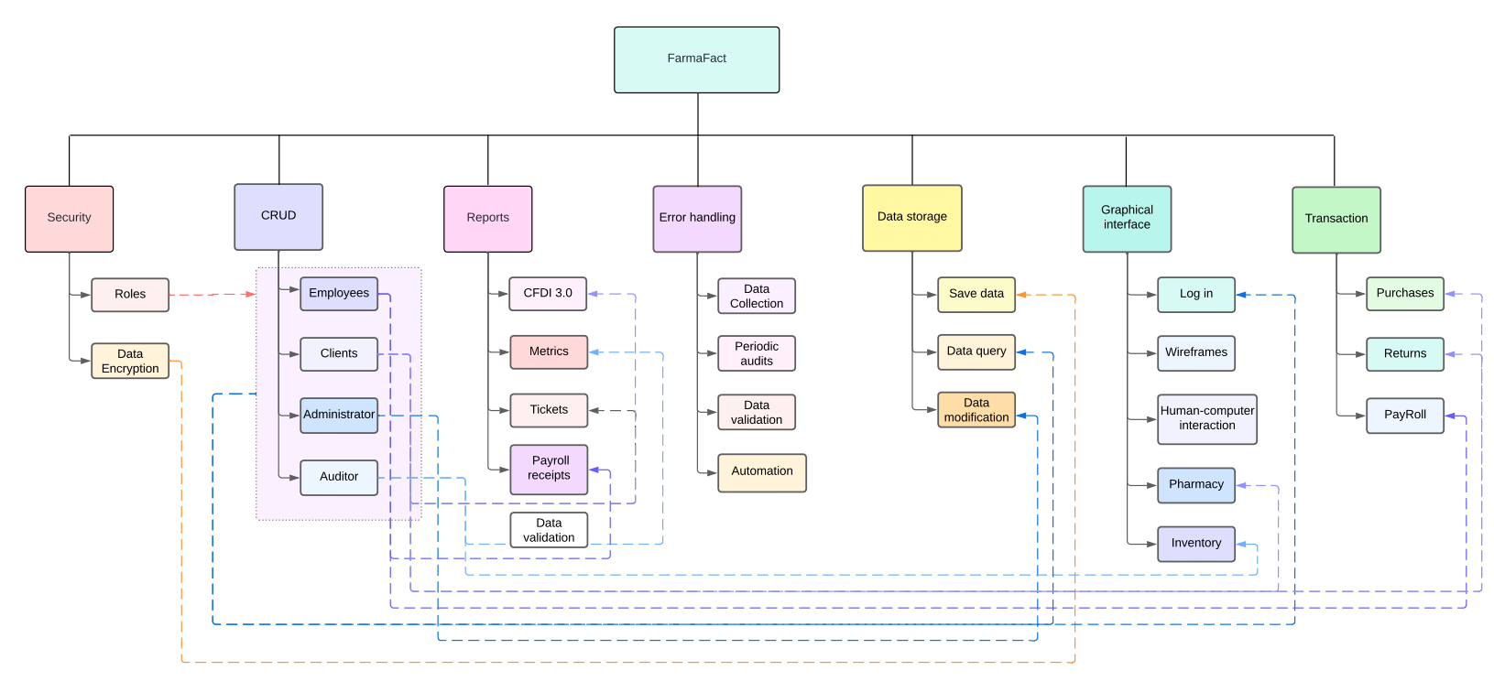
WBS

Slide 14
Lessons Learned
Difficulties don’t have to let you down.
Communication is key to finish any Project.
It’s important to know how to react to unexpected events and adapt to any circumstances.
Believe in your teammates.

Slide 15
Thanks for your attention!

